Slide 1


Slide 2
INTRODUCTIONS
A Microfinance Institution (MFI) is an organization that offers financial services to low income populations. MFS becomes very useful when targeting especially the unbanked poor families living in remote areas with not much sources of income. The Microfinance services (MFS) provided by MFI are Group Loans, Agricultural Loans, Individual Business Loans and so on,today, microfinance is widely accepted as a poverty-reduction tool, representing $70 billion in outstanding loans and a global outreach of 200 million clients.

Slide 3
In this particular scenario we are dealing with one such client in the Telecom industry, They have launched various products and have developed its business and organization based on the budget operator model, offering better products at Lower Prices to all value conscious customers through a strategy of disruptive innovation that focuses on the subscriber.
In this project we have got the data of two lakh and 9 thousand + users, and we have almost 37 columns for every user ,we have two categories in the target variable telling whether user had paid or not, The amount of data on each catagory is not same.

Slide 4
BASIC OUTLOOOK OVER DATA
Regarding the shape of the data , this data consist of 209593 rows and 37 columns.
Regarding the dtypes of the data most of the columns are floats and then integer and we have one object.
A significant number of columns have same type of data,like same data is been provided for 30 days and also for 90 days for the same content.
In most of the columns there were no null values.
Some datas were like exceptions.
In total the data set was huge and requires time for processing.

Slide 5
Exploratory Data Analysis
Through EDA we got many hidden informations which were there in dataset.
We carried three types of EDA proceders to take out the hidden informations,
Univariate Analysis: In this analysis we examined each variables separately to know whether any exceptions are there,
In this exercise we use distplot to know any skewness is there , on the other hand we use boxplot to know any outliers are there or not etc,
From Univariate analysis if exception data is there we can note that down and we can remove those data in data cleaning.

Slide 6
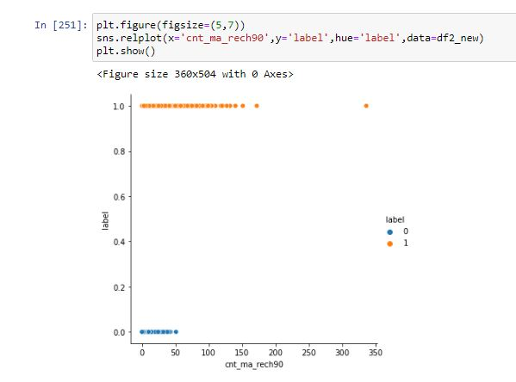
2.Bivariate Analysis:
In this analysis we analyse two variables simultaneously to see the insight of the data.
The cruicial informations about the data can be drawn through this analysis.
One example is as follows:

Slide 7
From above example on bivariate analysis we can conclude that if the the main account is recharged more than 50 times in 90 days then that user willbelong to label 1 infering that he will pay the loan within the time.
Multivariate Analysis:
From multivariate analysis we can get to know how
each variables are related to one another,
From multivariate analysis we can get to know the
correlation values between the variables.
From multivariable analysis we can group the data
based on the target variables.

Slide 8
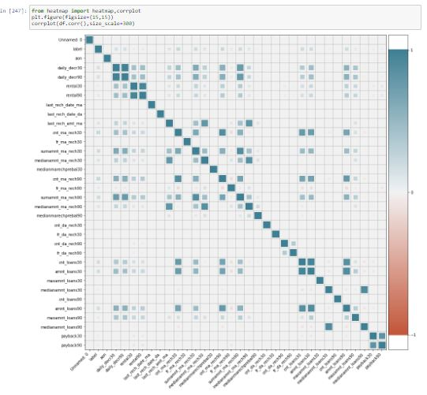
Example of Multivariate Analysis

Slide 9
From the above Multivariable analysis we can clearly infer that those variables which were correlated have square grid,how strongly they got correlated is depends on how thick is the square grid are.
From multivarible analysis we also get to know the correlation value between variables and also whether they are possitively correlated or negatively correlated.
For Multivariable analysis we majorly use heatmaps,correlation plots and groupby functions because they depicts more informations regarding the variables at a time.

Slide 10
ALGORITHMS USED
1.Logistic Regression:
This is the basic parameter for classification type of problem.
The outcome from the following technique is as follows:
Accuracy score=0.896
Cross validation score=0.896
2.GaussianNB
Accuracy score=0.751
Cross validation score=0.751
3.Support Vector Classifier
Accuracy score=0.898
Cross validation score=0.883
4.Decision Tree Classifier
Accuracy score=0.864
Cross validation score=0.863

Slide 11
5.KneighborsClassifier:
Accuracy_score=0.901
Cross val score=0.902
6.Random Forest Classifier
Accuracy score=0.906
Cross val score=0.905
7.Adaboost Classifier
Accuracy score=0.902
Cross validation score=0.901
From the above observations we can see that the defference between Accuracy score and cross val score is least for the LogisticRegression so its the best model.

Slide 12
Major Conclusions
There are some conclusions from data analysis which may be helpful for the client.
The number of times the main account got recharged in last 90 days is 0 for the user who wont pay in the most of the cases.
All those user who wont pay or label 0 have rental 90 less than 18.85k.
Most of the user who wont pay have an data of 0 times they have recharged their main account in last 90 days.
most of the user who wont pay have an last recharge to main account as 0 rupiah.
.In case of total number of loans taken by user is more than 170 in 90 days then that user certainly belongs to label 1.
1.Those people who have recharged their main account in last 3 months for more than 50 times always belongs to label 1.

Slide 13
Thank You

